Slide 1
3-phase Symmetrical Fault Analysis
VM Sandeep Rao - 107108105
Yash Kampoowale - 107108095
Sambhav R Jain - 107108103

Slide 2
PROBLEM STATEMENT
To write a MATLAB program to perform the complete fault analysis (finding fault current, during fault voltages, line flows) for a three phase symmetrical fault.

Slide 3
Flowchart
Y_{bus}
Accept the physical impedances between buses of the power system network from the user
Formulate the Y_{bus} matrix from the physical admittances
Type of Fault
Compute the fault current at the bus with the 3-phase fault
V_{f}
Compute the difference matrix, by multiplying the Z_{bus} with the injected fault current matrix
Accept from the user, the bus at which the 3-phase fault is to be simulated
Z_{bus}
Invert the Y_{bus} matrix to obtain the Z_{bus} matrix of the given network
I_{f}
Also ask if it is a bolted fault or a fault through an impedance
Add the pre-fault voltages to the difference matrix to get the during-fault voltages
Line flows
From the knowledge of during-fault voltages at the buses and the physical impedances between them, the line flows can be calculated
Assume the pre-fault voltages at all buses are 1 p.u.

Slide 4
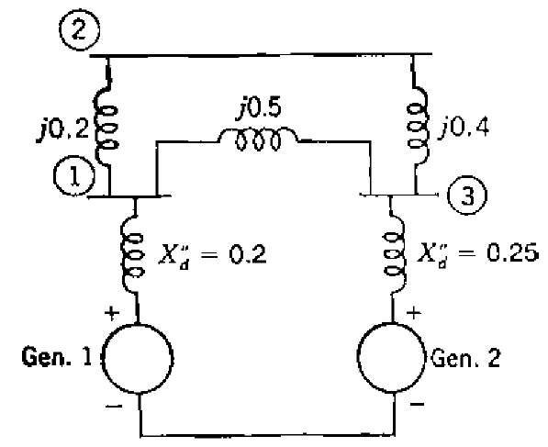
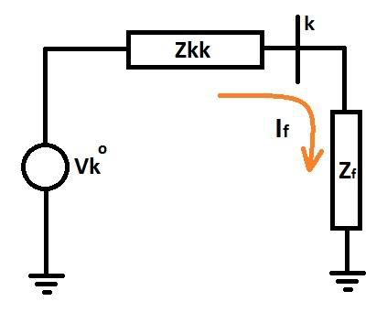
Power system network
Network
Thevenin equivalent

Slide 5
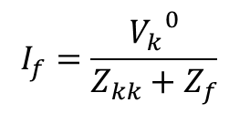
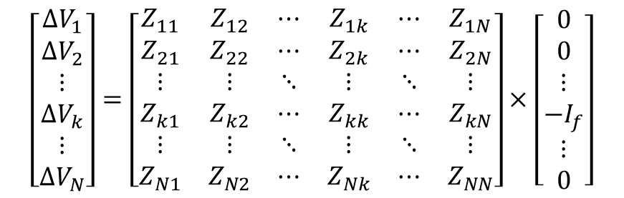
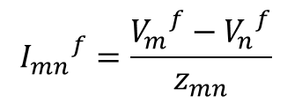
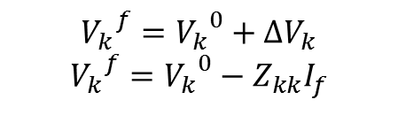
Fault analysis - equations
$$I_{f}=\frac{{V_{k}}^{0}}{Z_{kk}+Z_{f}}$$
$$\left[\begin{matrix}∆V_{1} \\ ∆V_{2} \\ ⋮ \\ ∆V_{k} \\ ⋮ \\ ∆V_{N}\end{matrix}\right]=\left[\begin{matrix}Z_{11} & Z_{12} & ⋯ & Z_{1k} & ⋯ & Z_{1N} \\ Z_{21} & Z_{22} & ⋯ & Z_{2k} & ⋯ & Z_{2N} \\ ⋮ & ⋮ & ⋱ & ⋮ & ⋱ & ⋮ \\ Z_{k1} & Z_{k2} & ⋯ & Z_{kk} & ⋯ & Z_{kN} \\ ⋮ & ⋮ & ⋱ & ⋮ & ⋱ & ⋮ \\ Z_{N1} & Z_{N2} & ⋯ & Z_{Nk} & ⋯ & Z_{NN}\end{matrix}\right]×\left[\begin{matrix}0 \\ 0 \\ ⋮ \\ −I_{f} \\ ⋮ \\ 0\end{matrix}\right]$$
$${V_{k}}^{f}={V_{k}}^{0}+∆V_{k}$$
$${V_{k}}^{f}={V_{k}}^{0}−Z_{kk}I_{f}$$
$${I_{mn}}^{f}=\frac{{V_{m}}^{f}−{V_{n}}^{f}}{z_{mn}}$$

Slide 6
Terminal Output
3-phase symmetrical fault analysis
Enter the number of buses in the existing power system (excluding reference bus): 3
Assume
1. Reference bus is denoted by "0"
2. If there is no impedance between two buses, enter NaN
Enter the physical impedances between buses:
Enter the z(1,2) (e.g. 2j): 0.2j
Enter the z(1,3) (e.g. 2j): 0.5j
Enter the z(1,0) (e.g. 2j): 0.2j
Enter the z(2,3) (e.g. 2j): 0.4j
Enter the z(2,0) (e.g. 2j): NaN
Enter the z(3,0) (e.g. 2j): 0.25j
The Zbus of the given power system is:
0 + 0.1447i 0 + 0.1195i 0 + 0.0692i
0 + 0.1195i 0 + 0.2465i 0 + 0.1006i
0 + 0.0692i 0 + 0.1006i 0 + 0.1635i

Slide 7
Terminal Output
For bus 1:
1 -> Generator bus
2 -> Load bus
Choose: 1
For bus 2:
1 -> Generator bus
2 -> Load bus
Choose: 2
For bus 3:
1 -> Generator bus
2 -> Load bus
Choose: 1
Enter the bus index at which a 3-phase fault is to be simulated: 4
Error!! Please enter a value between 1 and 3!
Enter the bus index at which a 3-phase fault is to be simulated: 2
Enter the fault impedance (zero in case of bolted fault): 0

Slide 8
Terminal Output
Per-unit fault current out of bus 2:
0 - 4.0561i
During-fault voltages (p.u.):
Vf_1 = 0.5153
Vf_2 = 0
Vf_3 = 0.5918
During-fault currents (p.u.):
If_12 = 0 - 2.5765i
If_13 = 0 + 0.1531i
If_23 = 0 + 1.4796i
If_g1 = 0 - 2.4235i
If_g3 = 0 - 1.6327i

Slide 9
Results and Discussion
The equations required to perform the 3-phase symmetrical fault analysis are derived for an N-bus system, to support any generic system
The N-bus system is treated as an N-port network and hence its Thevenin circuit is used to obtain the fault current
A MATLAB code is written to simulate the fault at any specified bus, in a given power system network
The fault current and during fault voltages are computed, from which, the line flows are calculated and displayed
By repeatedly simulating the fault analysis at different buses in a network, the rating of the circuit breaker can be determined from the maximum of line current during each of these simulations

Slide 10
Thank you!

